Slide 1
Lesson 9 – Reflection API, Annotations

Slide 2
Lesson goals
JVM and Memory
java.lang.reflect
java.lang.annotation

Slide 3
JVM Structure
*.class
CLASS LOADER
Runtime Data Area
Heap Memory
Non-heap Memory
Java Stack
Native method stack
GC
Execution Engine
Native Interface
Native Libs
*.dll

Slide 4
JVM Structure. Java Heap
Java Heap space is used by java runtime to allocate memory to Objects and JRE classes. Whenever we create any object, it’s always created in the Heap space.
Garbage Collection runs on the heap memory to free the memory used by objects that doesn’t have any reference. Any object created in the heap space has global access and can be referenced from anywhere of the application.

Slide 5
JVM Structure. Java Stack
Java Stack memory is used for execution of a thread. They contain method specific values that are short-lived and references to other objects in the heap that are getting referred from the method.
Stack memory is always referenced in LIFO (Last-In-First-Out) order. Whenever a method is invoked, a new block is created in the stack memory for the method to hold local primitive values and reference to other objects in the method.
As soon as method ends, the block becomes unused and become available for next method.
Stack memory size is very less compared to Heap memory.

Slide 6
JVM Structure. Java Heap/Stack
We can use -Xms and -Xmx JVM option to define the startup size and maximum size of heap memory. We can use -Xss to define the stack memory size.
When stack memory is full, Java runtime throws java.lang.StackOverFlowError whereas if heap memory is full, it throws java.lang.OutOfMemoryError: Java Heap Space error.

Slide 7
ClassLoader
Class loaders are responsible for loading Java classes during runtime dynamically to the JVM
It is possible to implement your own Class loader
Almost all Java-based containers such servlet containers implement custom ClassLoaders to support features like hot deployment and runtime platform extensibility

Slide 8
ClassLoader
There are three two types of built-in ClassLoader in Java:
Bootstrap Class Loader – It loads JDK internal classes, typically loads rt.jar and other core classes for example java.lang.* package classes
Extensions Class Loader – It loads classes from the JDK extensions directory, usually $JAVA_HOME/lib/ext directory (no longer supported in Java 11)
System Class Loader – It loads classes from the current classpath that can be set while invoking a program using –cp or –classpath command line options.

Slide 9
ClassLoader
public class ClassLoaderTest { public static void main(String[] args) { System.out.println("class loader for HashMap: " + java.util.HashMap.class.getClassLoader()); System.out.println("class loader for this class: " + ClassLoaderTest.class.getClassLoader()); System.out.println("class loader for external lib class: " + com.google.gson.Gson.class.getClassLoader()); } }

Slide 10
ClassLoader
class loader for HashMap:
null
class loader for this class:
jdk.internal.loader.ClassLoaders$AppClassLoader@77556fd
class loader for external lib class:
jdk.internal.loader.ClassLoaders$AppClassLoader@77556fd

Slide 11
Native Methods
JNI (Java Native Interface) - standard mechanism for running code that is written in C / C ++ or Assembler languages, and is assembled as dynamic libraries
//native method declaration
public native int nativeMethod();
Java Application
JNI
DLL

Slide 12
Reflection API
The ability to examine or modify the runtime behavior of applications
read properties
update data
change model

Slide 13
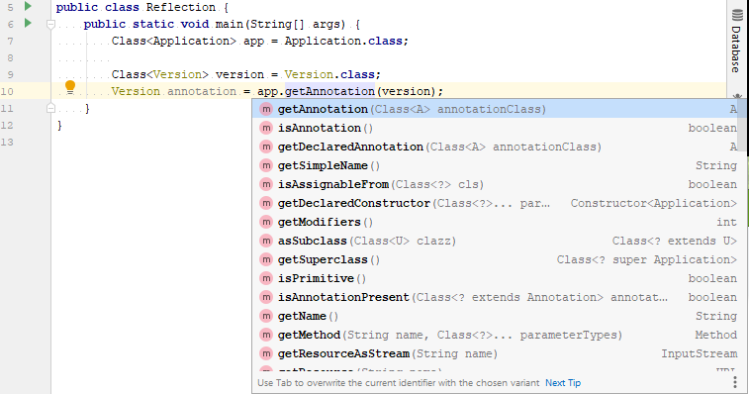
Reflection API

Slide 14
java.lang.Class
get the metadata of a class at run time
examine and change the run time behavior of a class

Slide 15
Class obtaining
forName() method of Class class
Class clazz = Class.forName(“org.geekhub.App");
getClass() method of Object class
Class clazz = instance.getClass();
the .class syntax
Class clazz = App.class
By classloader

Slide 16
Class instantiation
try {
Class<App> clazz = App.class;
App app = clazz.newInstance(); //requires no-args constructor log(app.getName()); } catch (InstantiationException | IllegalAccessException e) { log("Can not instantiate App by reflection: {}“, e.getMessage()); }

Slide 17
Class instantiation
try { Class[] argTypes = {
int.class, String.class, String.class
}; Constructor<App> constructor = clazz.getConstructor(argTypes); App app = constructor.newInstance(1, “App", "Some App desc"); log(app); //App{id=1, name=‘App’, description=‘Some App desc’} } catch (Exception e) { log("Error: {}", e.getMessage()); }

Slide 18
Declared fields
includes public, protected, default (package) access, and private fields, but excludes inherited fields
Class<App> clazz = App.class; Field[] declaredFields = clazz.getDeclaredFields(); for (Field field : declaredFields) { log("\t" + field); }

Slide 19
Fields
includes all the public fields up the entire class hierarchy
Class<App> clazz = App.class; Field[] fields = clazz.getFields(); for (Field field : fields) { log("\t" + field); }

Slide 20
Declared methods
includes public, protected, default (package) access, and private methods, but excluding inherited methods
Class<App> clazz = App.class; Method[] declaredMethods = clazz.getDeclaredMethods(); for (Method method : declaredMethods) { log("\t" + method); }

Slide 21
Methods
includes all the public methods up the entire class hierarchy
Class<App> clazz = App.class; Method[] methods = clazz.getMethods(); for (Method method : methods) { log("\t" + method); }

Slide 22
Invisible field update
Class<User> userClass = User.class; User user = new User(1, "John", 20, "UTF"); log(user.name); // John try { Field nameField = userClass.getDeclaredField("name"); nameField.setAccessible(true); nameField.set(user, "Roberto"); log(user.name); // Roberto } catch (NoSuchFieldException | IllegalAccessException e) { log("Error: {}“, e.getMessage()); }

Slide 23
Invisible method invocation
Class<User> userClass = User.class; User user = new User(1, "John", 20, "UTF");
log(user.name); // John try { Method setter = userClass.getDeclaredMethod("setName", String.class); nameSetter.setAccessible(true); nameSetter.invoke(user, "Roberto"); log(user.name); // Roberto } catch (NoSuchMethodException | IllegalAccessException | InvocationTargetException e) { log("Error: {}“, e.getMessage()); }

Slide 24
Annotations
@Deprecated
@Override
@SuppressWarnings
@FunctionalInterface
@NonNull
…

Slide 25
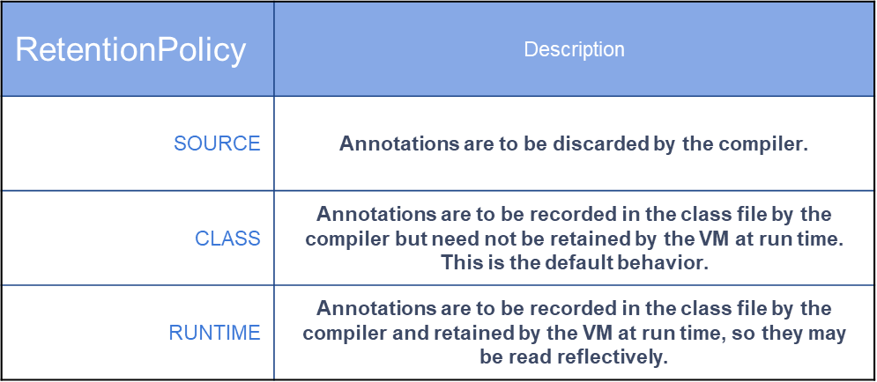
Annotations. RetentionPolicy

Slide 26
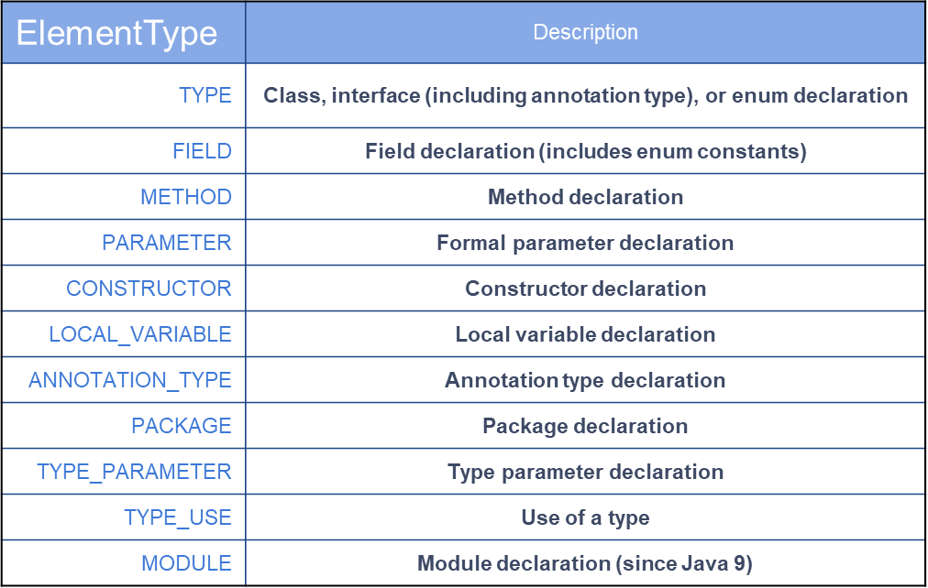
Annotations. ElementType

Slide 27
Annotations
@Target(value = ElementType.METHOD) @Retention(value = RetentionPolicy.RUNTIME) public @interface Version { int min(); int max(); String description() default ""; }

Slide 28
Annotations
class ApiClass { @Version // required attributes are missed void api0(){}
@Deprecated @Version(min = 1, max = 2) void api1(){}
@Version(min = 2, max = 3, description = “Some description") void api2(){} } @Version // wrong target element type class ApiClass2 {}

Slide 29
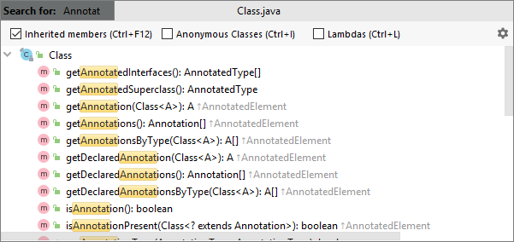
Class annotations usage

Slide 30
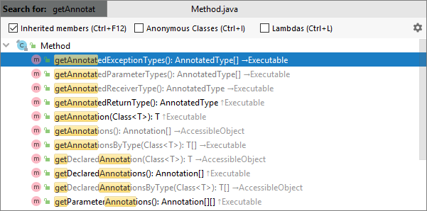
Method annotations usage

Slide 31
Homework
Implement your own annotations:
@Codec(algorithm = Algorithms.MORSE/Algorithms.CAESAR/…) – add this annotation to all codec classes with algorithm name specified
@Key – (can be applied for Vigenere only)
@Alphabet - (can be applied for Vigenere, Caesar)
@Shift - (can be applied for Caesar only)

Slide 32
Homework
Change implementation of DecodersFactory and EncodersFactory:
Remove switch statement
Find class marked by @Codec annotation with algorithm = {specified algorithm} and implements Decoder/Encoder interface using Reflection API
Create instance of found class by no-arg constructor using Reflection API
Set values of key/alphabet/shift (where appliable) from properties using Reflection API (key/alphabet/shift should be marked by appropriate annotation)
To determine which alphabet should be used use value from @Codec annotation
Throw exception in case annotation used incorrectly:
@Codec – used for class that does not implements Decoder/Encoder interface
@Key – used for algorithm does not use key (for example: Caesar)
@Alphabet - used for algorithm does not use alphabet (for example: VigenereX2)
@Shift – used for class that does use shift (for example: Morse)

Slide 33
Links
Reflection API
Using java reflection
Annotations
Memory model
Java classloaders

Slide 34
Thanks!
Any Questions?
Or find us in Slack:
@Yaroslav Brahinets
@Vasya Rudas
@Oleksandr Kucher

